Slide 1
Annual Title I Parent Meeting
Woodrow Wilson Elementary School

Slide 2
Title I Annual Meeting
The purpose of this meeting is to inform parents of Wilson Elementary School’s participation in the Title I program and to explain the Title I, Part A requirements and the right of parents to be involved in those programs.

Slide 3
What is Title I?
United States Federal Government’s largest education program to support public schools.
The Purpose:
To help academically disadvantaged children receive a high-quality education and to achieve the high academic standards set by the State of California.

Slide 4
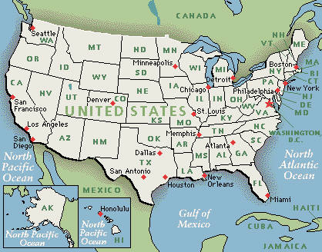
How is Title I funded?
The U.S. Department of Education gives a share of Title I funds to each state based on the percentage of poverty in the state.

Slide 5
How is Title I funded?
CA distributes the money to school districts based on need.
Districts distribute the money to schools based on the needs of each school.
Each school decides how Title I funds will be used to improve education for students.

Slide 6
How are Title I funds used at Wilson Elementary?
First - a leadership team reviews data and determines the greatest needs;
Second - the School Site Council (SSC) devises a plan (SPSA) with specific goals to improve student achievement;
Third - SSC decides Title I funds will be used to support student achievement;
Fourth - SSC monitors and implements the SPSA and makes necessary changes.

Slide 7
Assessments used to measure progress
The following assessments are used to measure student progress:
K – 3: BPST III (Basic Phonics Skills Test)
Grades 3 – 5: Benchmark Advance Interim Assessment. BPST III for students not meeting standards on Benchmark Advance MAP Testing – Fall, Winter and Spring.

Slide 8
Title I Programs at Wilson Elementary School
The following programs supplement the instruction of struggling students:
ST Math (Jiji)
Lexia Reading
myON Reading
Accelerated Reader (AR)

Slide 9
Title I Programs at Wilson Elementary School
The following programs support the development of a positive school culture and the socio-emotional well-being of our students:
PBIS (Positive Behavior Interventions and Support)
Outreach with Ms. Cristina
Turning Point Counseling Services
Parent Outreach with Ms. Lorena

Slide 10
Parent Engagement
Parents are an important part in the educational process.
Children are more successful when parents are involved in their children’s education.
Parent involvement in the planning of key initiatives is valued and important.

Slide 11
School Parental Engagement Policy
Each school must develop - jointly with parents of children participating in Title I - a written school parental involvement policy that describes how the school will engage and support parents in their child’s education - including the development of a school-parent compact
The policy is a promise to parents.
The compact is a promise to each other.

Slide 12
School-Parent Compact
The Compact is a promise from all stakeholders to commit to the academic achievement of students.
It must be annually reviewed with the input of parents and revised if necessary.
SSC approves the Parental Involvement Policy and School-Parent Compact annually.

Slide 13
In what ways can parents be involved at Wilson Elementary?
SSC / SPSA development
ELAC / DELAC input
Parent meetings
Parenting classes
Parent Teacher Organization (PTO)
Volunteering
Supporting learning at home

Slide 14
The SSC and the SPSA
The School Site Council (SSC) is a leadership group of teachers, parents, administrators, students (secondary only) and other stakeholders that is responsible for developing the Single Plan for Student Achievement (SPSA) – also known as the ”School Plan.”
The SPSA is developed from an analysis of student achievement data.
It is reviewed annually to determine the effectiveness of current programs.

Slide 15
ELAC and DELAC
English Learners Advisory Committee (ELAC)
This committee is a group of parents that meet to advise the school on concerns of English Learners.
Two ELAC members represent each school at the District English Learners Advisory Committee (DELAC)

Slide 16
Parent Rights
Parents have the right to:
be treated with courtesy by all members of the staff.
participate in meaningful parent-teacher conferences and to discuss the compact in relation to their child’s achievement.
request reports about their child’s progress.
visit schools and classes.

Slide 17
Questions and Answers
For more information on Title I please contact the English Learners Department at (714) 558-5855 or contact Wilson Elementary School’s principal – Ms. Erica Graves - at (714) 564-8105 or via email at erica.graves@sausd.us.

